Slide 1

Severstal Steel Defect Detection
Group 6
Mohammed Benkhial -8928209
Rohit Totlani - 8914803 Pradeepti Kasam - 8965985

Slide 2

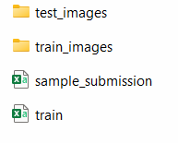
Dataset
Severstal: Steel Defect Detection Dataset
Link
Dataset CONTENTS
Classes
https://www.kaggle.com/c/severstal-steel-defect-detection/overview
indicating the location and Class of four different surface defects
Class 1: Pitted surface defect
Class 2: Crazing defect
Class 3: Scratches defect
Class 4: Patches defect

Slide 3
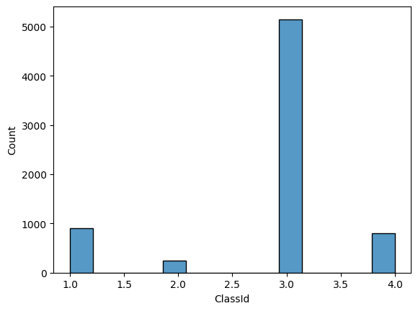
Class Label Count
Class 1, 2, 3,4 are the defect classes.
From the visualization its clear that class 3 is the most occurred defect.

Slide 4

Model Used
Techniques Used
Encoder
Decoder
U-Net–like Convolutional Neural Network (CNN)
specifically designed for defect segmentation.
Consists of an Encoder and a Decoder
Series of convolutional and pooling layers to capture image features
Up sampling layers to generate precise segmentation masks.

Slide 5
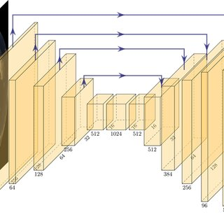
U-Net Model
U-Net is used due to its powerful segmentation capabilities.
Its encoder-decoder architecture efficiently captures both low-level and high-level features, allowing precise localization of defects.
The skip connections help retain fine details, making it ideal for detecting small and complex surface defects in steel images.

Slide 6
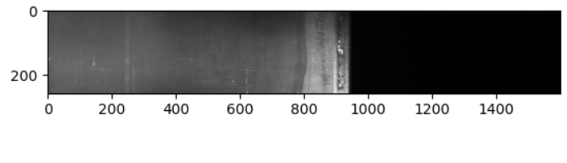
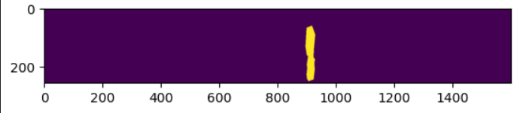
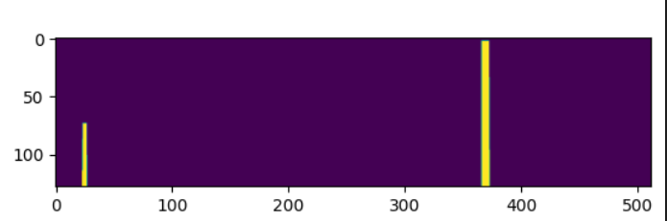
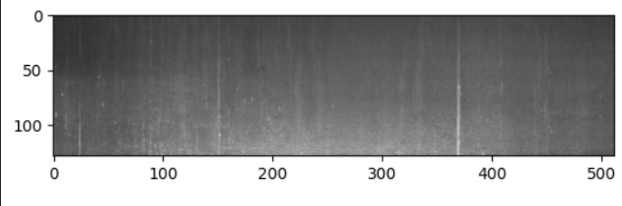
Sample image Before Masking
Sample image After Masking

Slide 7

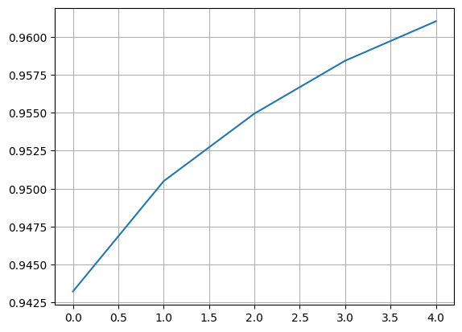
AI-Powered Defect Detection
Performance Metric
Interpretation
Average Metric Value: 0.9610
The model achieves a high level of accuracy in detecting defects, ensuring reliable quality control.

Slide 8
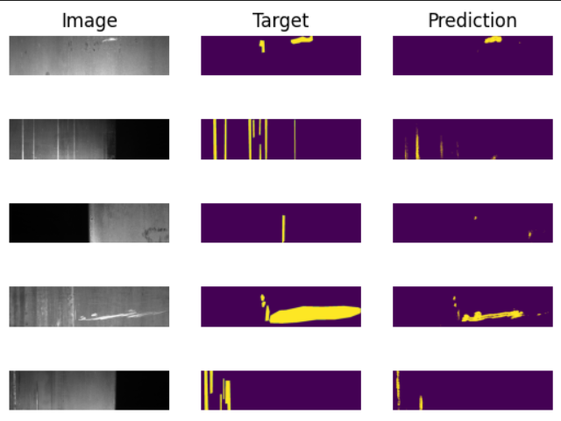
Ground Truth vs. Model Prediction

Slide 9

Conclusion :
In summary, the U-Net model effectively detects defects in steel sheets, achieving an accuracy of 96%.

Slide 10

How Can we effectively implement A/B testing ?
Control Group:
Method: Traditional manual defect detection performed by human inspectors.
Role: Acts as the baseline or current standard of quality control.
Treatment Group:
Method: Automated defect detection using the AI model (DefectDetectionNet).
Role: Represents the new approach being evaluated for improved accuracy and efficiency.
Comparison:
Metrics: Detection accuracy, speed, cost-effectiveness (false positives/negatives).
Process: Both groups inspect the same steel sheets; performance is measured using common metrics and statistically compared to determine significant improvement by the AI model.

Slide 11

Where can Severstal integrate the model ?
Deployment Location
Implementation Steps
Integrated directly into the production line’s quality control system.
Image Capture
High-resolution cameras collect images of steel sheets in real-time
AI Inference
Captured images are fed into the DefectDetectionNet model.
The model processes and identifies defect regions using segmentation
Real-Time Feedback
Detected defects trigger alerts for immediate action.
Data is logged for further process optimization and quality analysis.

Slide 12

Thank You
Group 6
Mohammed Benkhial -8928209
Rohit Totlani - 8914803 Pradeepti Kasam - 8965985

